Slide 1
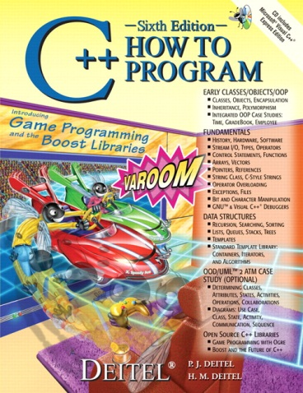
205SE Programming for Engineers
Introduction
2019

Slide 2

Welcome from the Teaching Staff
Chris Bass (Module Leader)
Chris.Bass@coventry.ac.uk
aa6164@coventry.ac.uk

Slide 3

What is this module all about?
Software Engineering!
The development and building of computer systems software and applications software
Learning to write C++ code
Solving engineering problems, not computer science
Less theory
More practical programming

Slide 4
Why you should learn to code:
“If computers are at all a part of your life, then learning to program is going to improve your life” – Dave McFarland
Coding skills are useful in many of your everyday tasks:
Helps when problem solving – view problems differently
You become extremely efficient at breaking a problem down to its bare essential steps
You can write code scripts to automate your daily tasks
Helps when writing calculations and formulas in MS Excel
You can be creative in a new way – total creative freedom
Programs are really, really good at doing chores
You can write code to do valuable work for you – save time

Slide 5




Learn the skills you need, if you want to or might want to be a future:
Application Developer – WindowsOS, MacOS, Unix, Android…
Got an idea for an Android App or Game?
Games/Graphics Coder – OpenGL, DirectX, Unreal Engine…
Systems Developer – Server, DB, SQL, Model
Embedded Systems Engineer – STM32 ARM chips, PIC32…
Electronics Engineering – Microcontrollers, Robotics
Artificial Intelligence – Learning Algorithms
Crypto-currency Software – Bitcoin!, Blockchain, Finance.

Slide 6
Major branches and career paths in Software Engineering include:
Applications Development
Systems Development
Embedded Systems Development
Problem solving-based, non-Web-based software development that includes programming languages such as Java and C#. Client-side programmer, GUI.
Designing and coding background software created to support application development; includes program languages like C and C++. Server-side, DB.
Designing computing systems and software to work on devices such as automobiles, microcontrollers. Program languages such as C and assembly.
Web Development
Designing software or applications to run in a Web browser and used programming languages such as HTML, JavaScript and PHP.

Slide 7
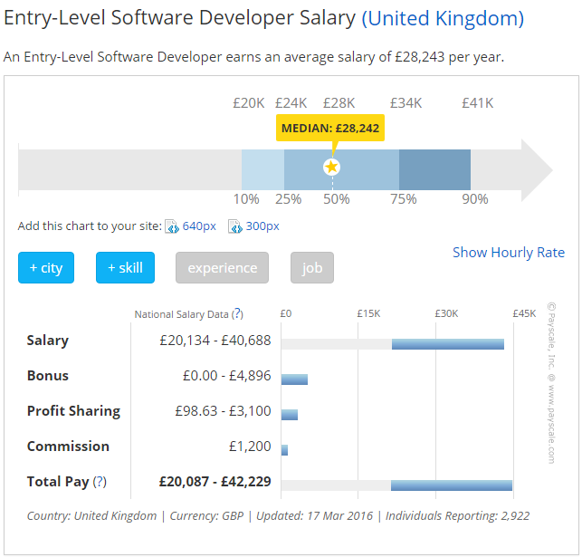
Surge in Software Engineer Careers at all levels.

Slide 8
205SE – Programming for Engineers Module Aims
This module aims to provide a foundation of computer programming skills for students studying in the fields of engineering and technology.
The module will develop basic problem solving skills for task-oriented problems consistent with the conventions of the Unified Modelling Language (UML).
Programs will be implemented using a block structured programming compatible language within an Integrated Development Environment (IDE).
An introduction will also be given to objects and classes.
The module is intended for students who have had little or informal experience of computer programming.
Notes:
Solving engineering problems, not computer science
Problem solving skills are useful in a range of contexts outside of programming too
UML and pseudo-code to analyse the problem and provide structure before programming
Console Diagrams, UML Activity Diagrams, UML Class Diagrams
Mostly C but in a C++ context/bubble
Software is available to students, instructions for obtaining are on Moodle
We assume students have no prior knowledge
Do not struggle, seek us out for help

Slide 9
Module Guide
Full Module Guide – Available on Moodle
Solving Engineering Problems; Not Computer Science
Object Oriented Analysis and Design through UML
C++ Fundamentals
Variables
Flow Control
Functions
Basic classes and objects
Text File I/O
Arrays and data structures
Pointers
To-do: Visit Module Guide on Moodle and go through Module Material.

Slide 10
Module Structure 2019
2 hour lecture/laptop session per week
Bring your own laptops to lecture slot
4 hour tutorial/PC lab per week
Essential to attend both
Lots of material to get through!
Short on time
Only 1 semester (11 teaching weeks) to learn 205SE C++
Lectures will be a mixture of theory and hands-on – laptop dependant (C++ programming)
Tutorials will be mostly hands-on/activity led (UML and C++ programming)

Slide 11
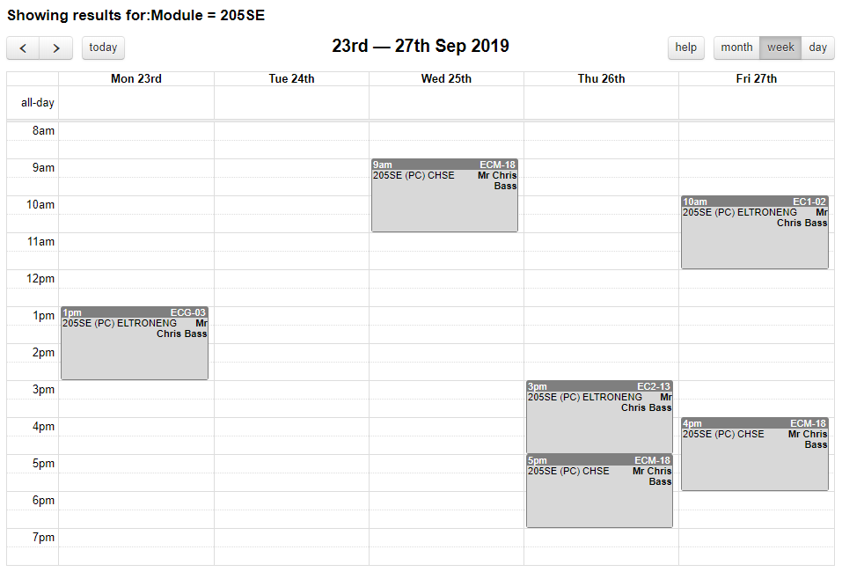
ECU132 – EE, ECU134 – CHSE
https://webapp.coventry.ac.uk/Timetable-main/

Slide 12
Practice makes Programmers
Essential to practice programming outside of scheduled class times to learn
Plan an additional 2 hour slot in your week outside of classes for C++ revision and practice with friends
Student activity and time spent on each activity comprises:
Guided | 134 hours | (66%)
Lecture | 24 hours | (12%)
Tutorial | 48 hours 66 hours | (24%) (33%)
Total | 200 hours
To-do: Decide in groups when you can arrange to meet for C++ revision and practice outside of class.

Slide 13

Homework
Practice is essential to getting good at programming.
To give you something to practice on, I have provided a homework question at the end of each tutorial slide.
You should try to do additional programming problems outside of class.
The more problems you attempt the better you will get.
Put the time in.
You can try lots more different programming problems to practice. There are many more problems online e.g.
https://adriann.github.io/programming_problems.html
There are links on Moodle to more practice material
Search for more programming problems online

Slide 14
Assessment 2019
Module mark = 50% coursework + 50% exam
Coursework worth 50% (40 hours)
Hand out today
Submission Friday, 06 December 2019 (T12)
Examination worth 50% (2 hours)
December exam period
Structure is answer all 4 questions out of 4
Exam revision closer to the time i.e. December (T11 - T12)
To-do: Note the submission date in your diary.

Slide 15
Software Tools
Microsoft Visual Studio IDE
Integrated Development Environment
Other IDEs Similar Layout
Writing, Building, Testing, Debugging – all-in-one package
Pragsoft UML Studio
UML Software Engineering Diagrams
Structure, Behavior, Interaction
UML Activity Diagram, Class Diagram
Notepad++ – lightweight editor
Visual Paradigm – as an alternative to UML Studio
Moodle – has instructions for obtaining software under “how to get the software for this module” link
We will investigate these software packages later on.

Slide 16
CU GitHub – Version Control System
https://github.coventry.ac.uk/205SE-1920SEPJAN
Repository for uploading coursework, homework, and lab work
Version Control
Accessible Anywhere

Slide 17

Intended Learning Outcomes
The intended learning outcomes are that on completion of this module the student should be able to:
Perform a methodical analysis and design of a block-structured, engineering programming problem consistent with the conventions of the UML.
Identify objects and classes and their relationships in simple object-oriented programming problems and represent them using the conventions of the UML.
Use an integrated development environment to create, compile, build and execute programs.
Implement a console application in a block-structured compatible programming language.

Slide 18
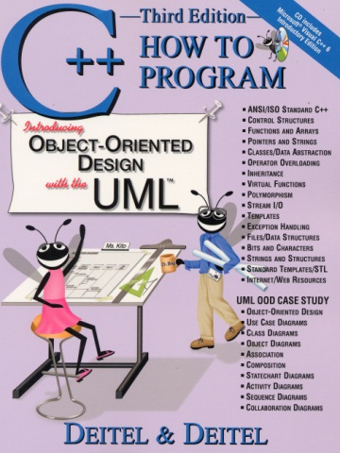
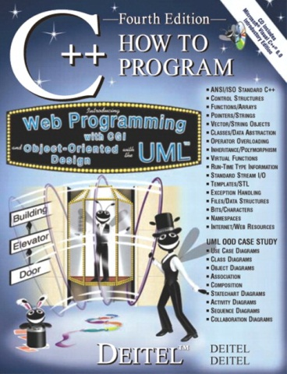
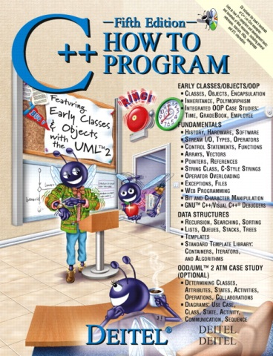
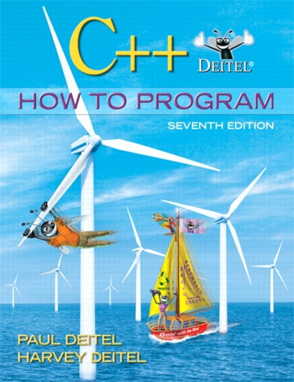

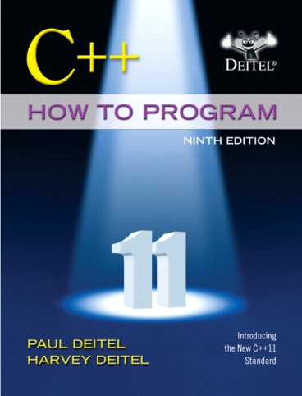
Essential Reading
DEITEL & DEITEL, (2008) C++ How To Program (6th Edn), Prentice Hall, Call No. 005.113 C++/DEI, ISBN-13; 978-0-13-615250-7, ISBN-10; 0-13-615250-3

Slide 19
Support and Additional Reading
If you need some extra support or guidance then please be pro-active and use:
Books e.g. Deitel and Deitel
Online e.g. http://www.stroustrup.com/glossary.html
Ask on Moodle ‘Hot Questions’
Answer in-class
Email

Slide 20

Today
What is block structured programming?
A look at C++
C++ tokens
The C++ compilation process
A look at UML Studio, Visual Studio IDE, Notepad++
Finding errors and debugging programs

Slide 21
Block-Structured Programming
A block-structured view of programming:
Focus is on the functions we have to perform
Encapsulating functions and function specific data into blocks and running them back to back
Getting away from the ‘spaghetti code’ goto statements of old
Process Block A
Process Block C
Process Block B

Slide 22
A look at C++
What makes up a C++ program?
Tokens, punctuation and white space
int a = 5 + 2;
Tokens
White space
Punctuation

Slide 23
C++ Tokens
C++ Tokens
Literal
Operator
Keyword
Identifier
To-do: Visit Stroustrup’s glossary and punch in these terms.
http://www.stroustrup.com/glossary.html

Slide 24

Identifier (name)
An identifier is a programmer defined name for something (case sensitive)
int a = 5;
a is the name for identifying this variable
int totalStudents = 75;
totalStudents is the identifier
string exclamation = "Oh... Joy!";
exclamation is the identifier

Slide 25

Keywords
Keywords have a meaning in the language
e.g. for declaring variable data types, type modifiers, conditional and looping structures, user-defined types
Keywords and other reserved words in the language cannot be used as identifiers
List of keywords on Moodle
int a = 5;
int is a keyword to mean we want to declare an integer variable

Slide 26

Literal (data)
A literal is a piece of data (a fixed value) expressed directly within the code (literally writing data into the code)
int a = 5;
5 is a literal constant integer
int b = 0x7E;
0xFE is a literal integer in hexadecimal base-16 representation
int c = 0b101;
0b101 is a literal integer in binary base-2 representation

Slide 27
Literal (data)
float d = 0.2e-001;
0.2e-001 is a literal constant floating point number
string e = "Hello World";
“hello world” is a literal constant string
char f = 'd';
‘d’ is a literal constant character

Slide 28

Operator
An operator is a built in symbol representing an operation to be performed
e.g. arithmetic, relational, logical, bitwise, assignment
int a = 5 + 2;
= is the assignment operator
+ is the addition operator
cout << "Hello World";
<< is the insertion operator

Slide 29
Terminology in an example program
Class questions:
1 student 1 answer
#include <iostream>
using namespace std;
int main()
{
int totalStudents = 75 + 2;
cout << "Hello World!";
return 0;
}
1. What’s this called?
2. What’s this called?
3. What’s this called?
4. What’s this called?

Slide 30

C vs. C++ and a quick timeline
C++ is based on C
Adds object-oriented capabilities to C
C (1969 - 1973) (32 keywords)
Early C++:
C with Classes (1979)
C++ (1983)
Standard C++ (ISO):
C++98
First international standard
C++03 or C++0x
No difference to the core language but much larger standard library
C++11 (86 keywords and reserved words)
Added new keywords to the language
C++14
Approved but not published yet? (2014)
C++17
The next major revision for the C++ standard

Slide 31
The C++ compilation process
Check out more details of the C++ compilation process on Moodle
Edit
Build
Preprocessor
Compiler (and Assembler)
Linking
Load and Execute
This can all be done from the IDE
The development process will usually add analysis, design, testing and debugging stages, then repeat.

Slide 32

A look at the software tools
Visual Studio 2010 Professional IDE
Microsoft DreamSpark Premium
https://www.dreamspark.com/Institution/Access.aspx
Coventry University – Engineering Computing – DreamSpark Premium
Register
Alternative: http://coventry.ac.onthehub.com
Ian Bowker or ITS
Code::Blocks IDE
http://www.codeblocks.org/
UMLStudio
http://www.pragsoft.com/
Visual Paradigm
https://www.visual-paradigm.com/
Notepad++
http://notepad-plus-plus.org/

Slide 33

The best way to learn C++?
Read compiler error messages!
Finding errors and debugging
An essential part to getting your programs working and learning is the debugging process
Make sure that you:
Read compiler errors
Use of cout
Debugging in the IDE
To-do: Let’s go through an example of each.

Slide 34
On to Tutorial 1 – Hello World !

